Slide 1
Networking
400IT – W2-S1

Slide 2
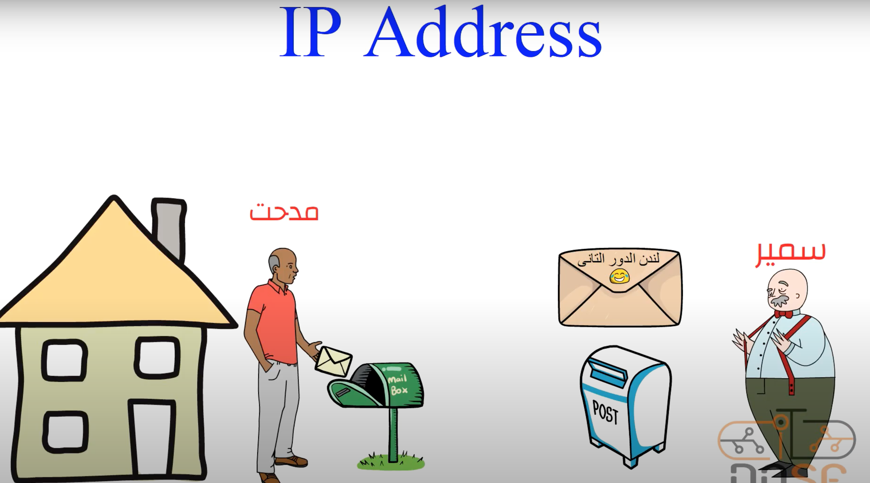
IP Address
Kingsley
Hampus

Slide 3
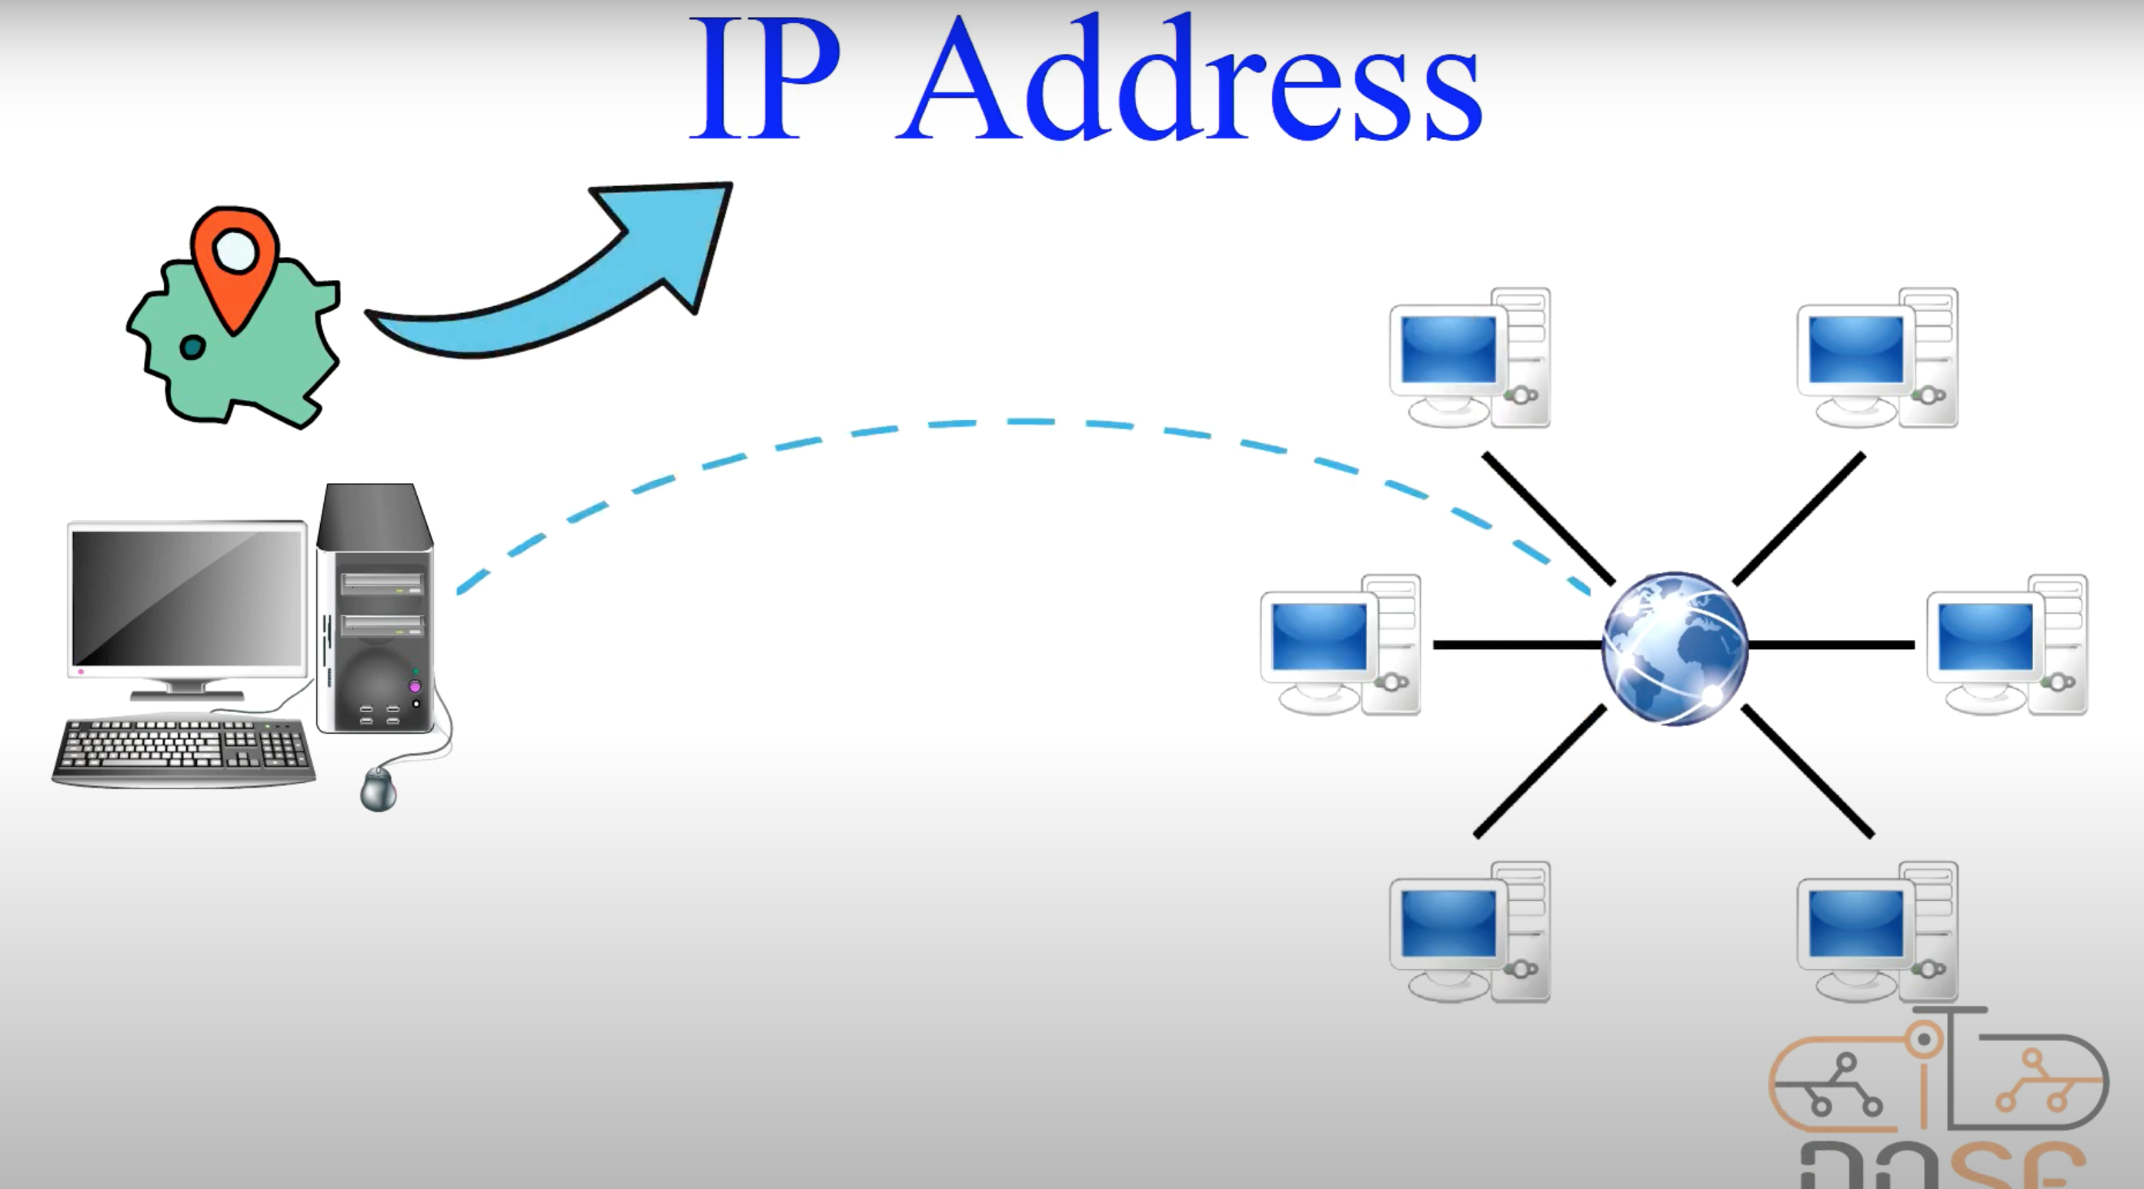
IP Address
An IP address is a unique numeric identifier assigned to devices connected to a network. It helps devices communicate with each other by allowing them to send and receive data packets.

Slide 4
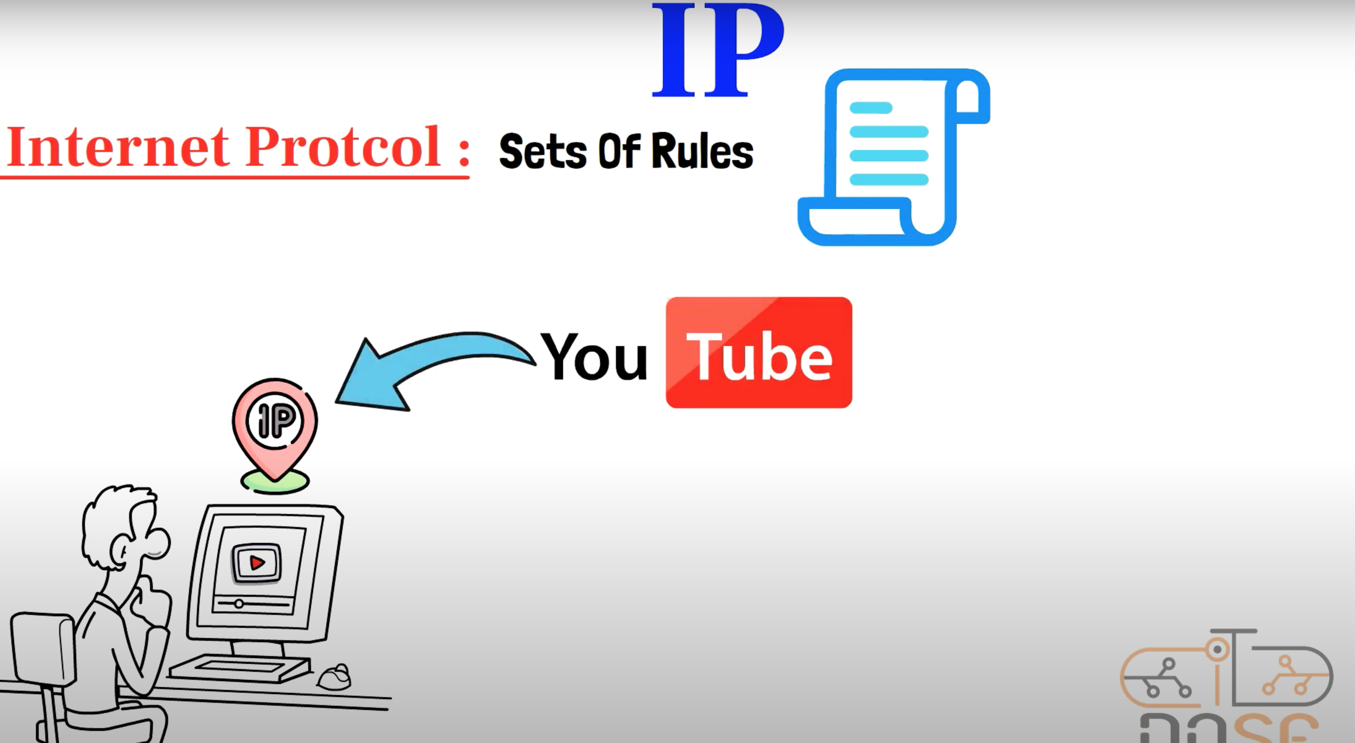
IP Address

Slide 5
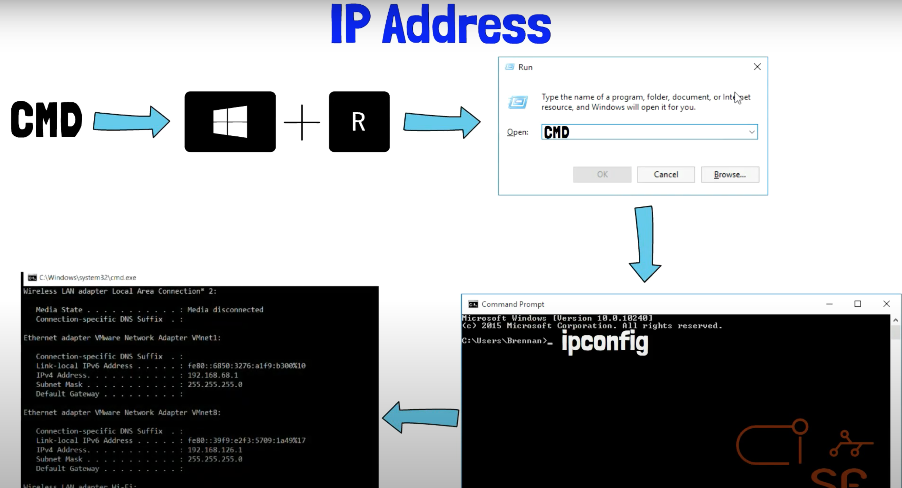
How to see your IP

Slide 6
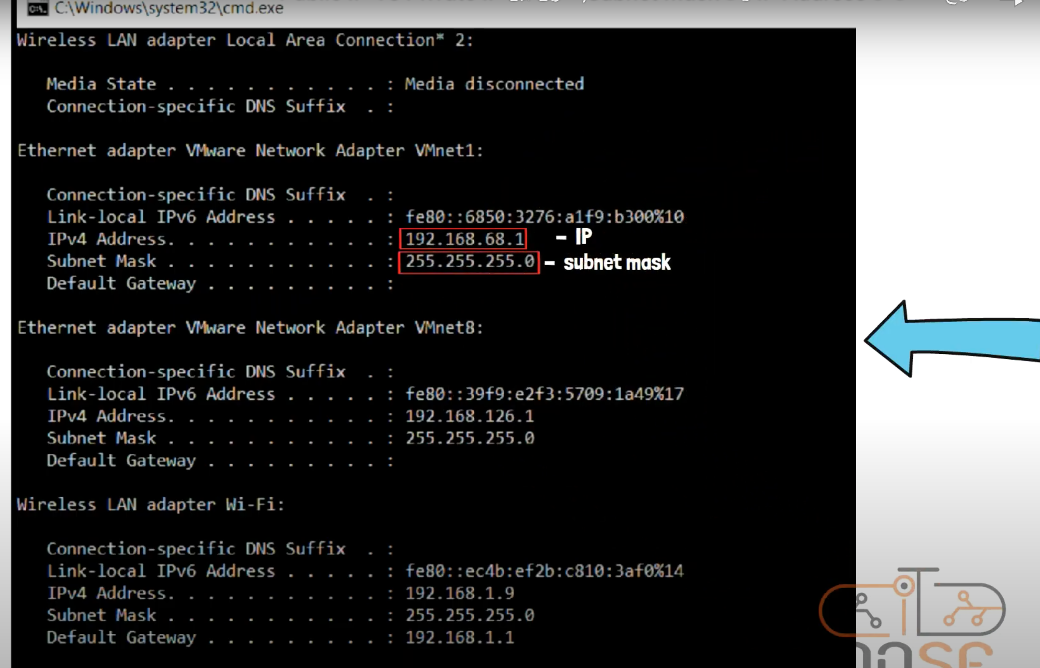
IP Address

Slide 7
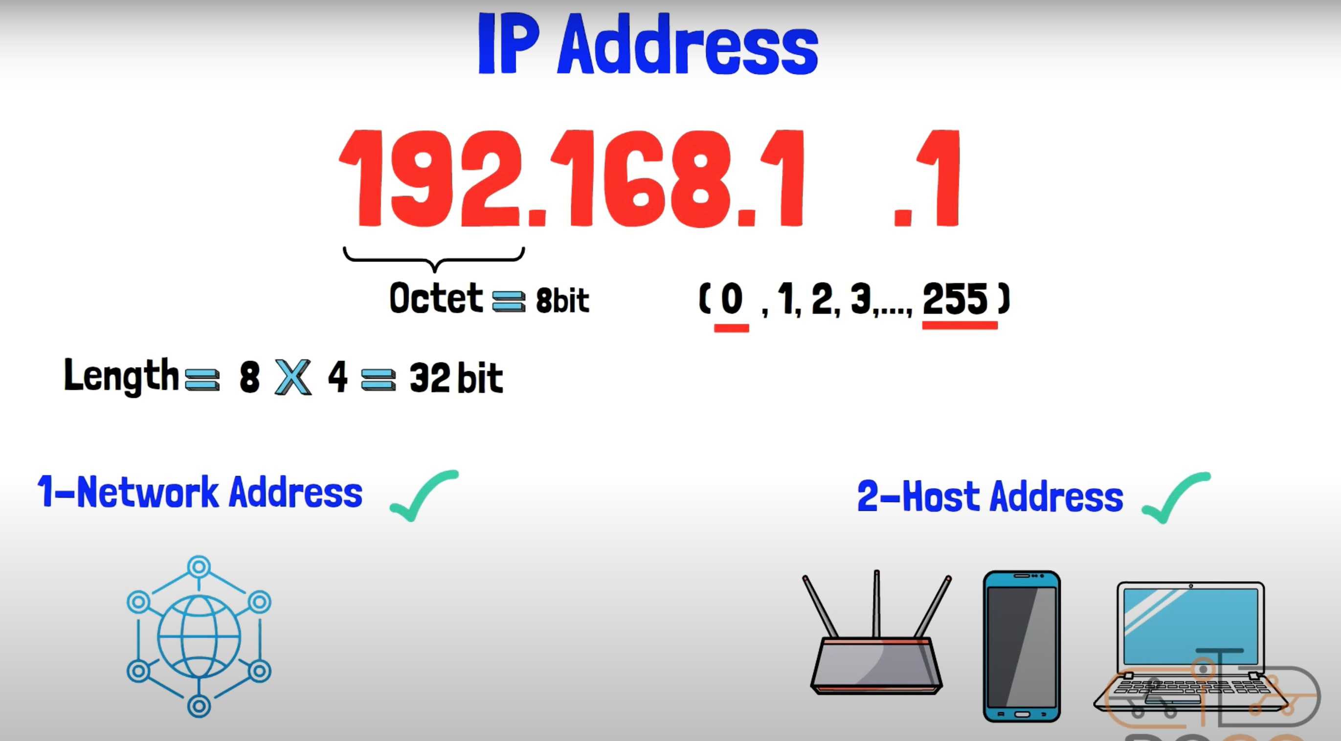
IP Address

Slide 8
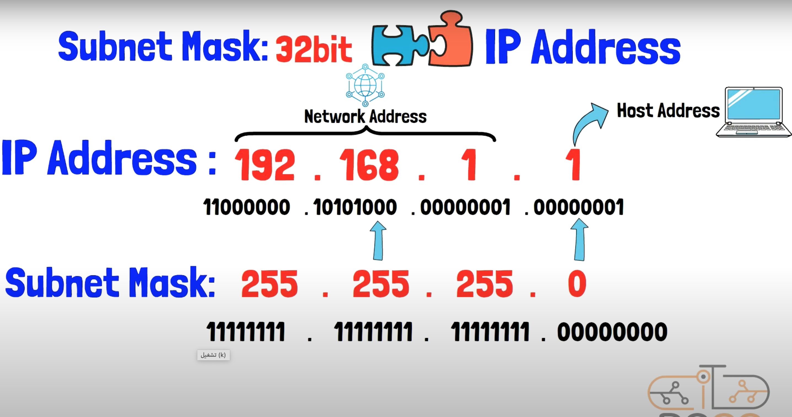
IP Address

Slide 9
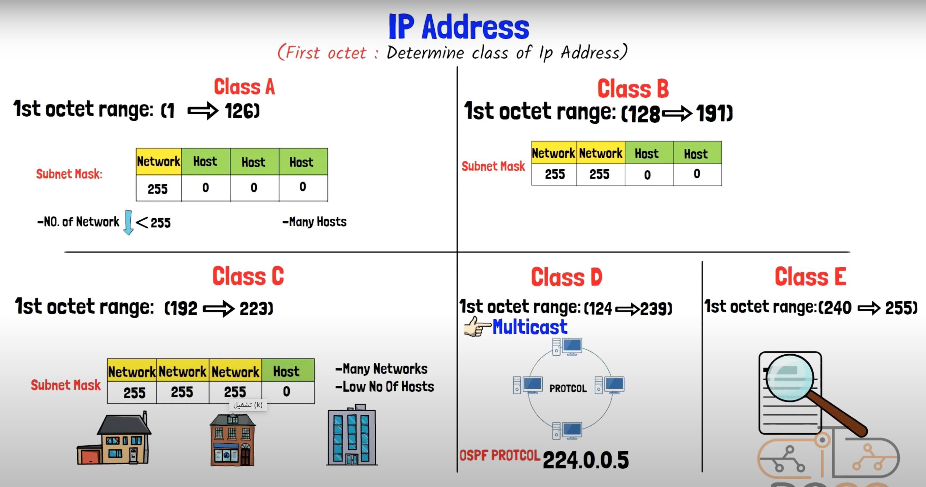
IP Address

Slide 10
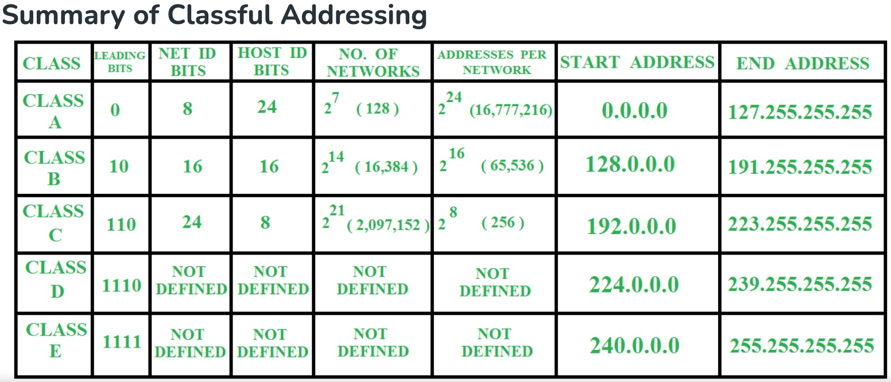
IP Address

Slide 11
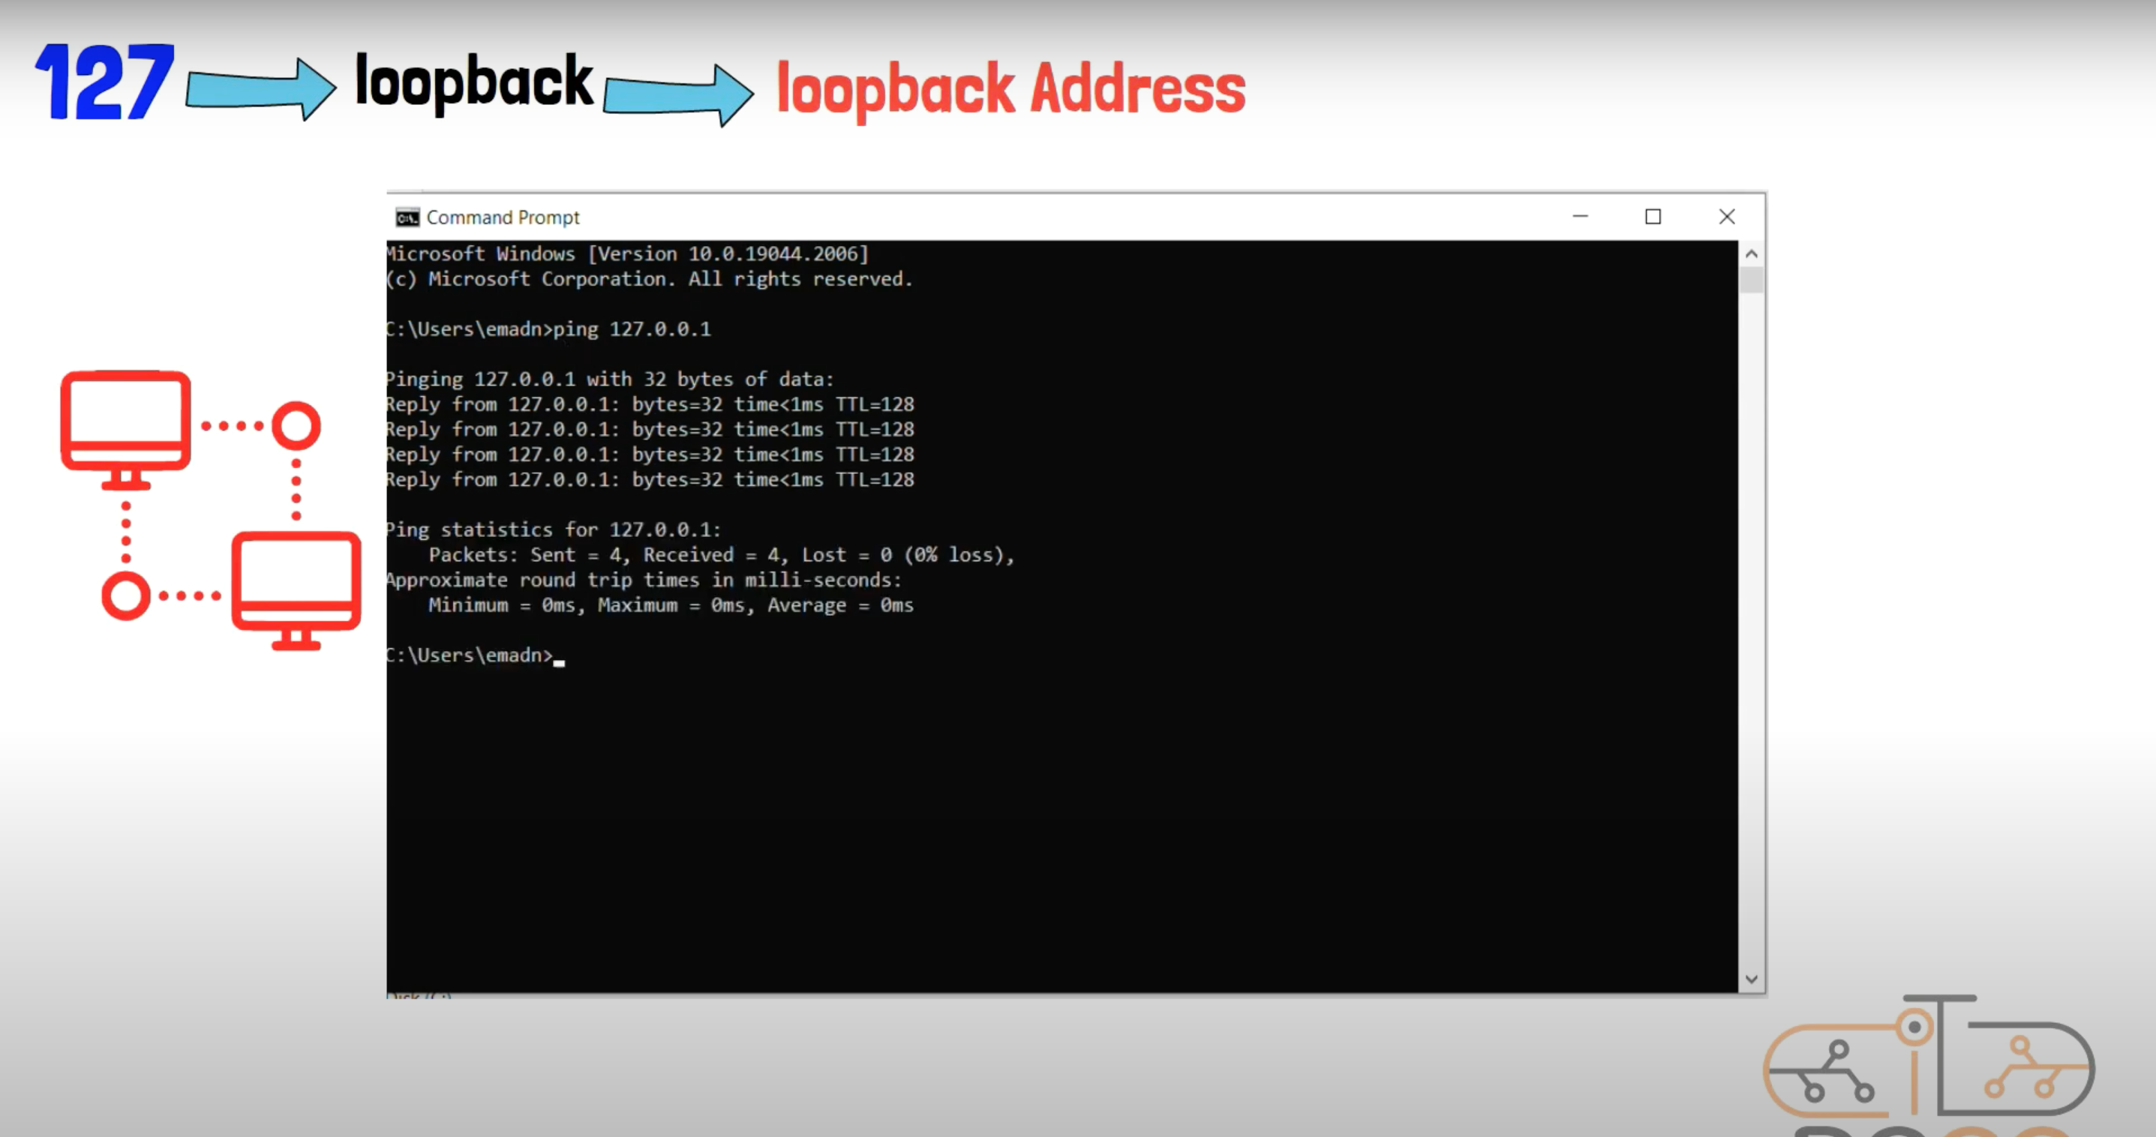
IP Address

Slide 12
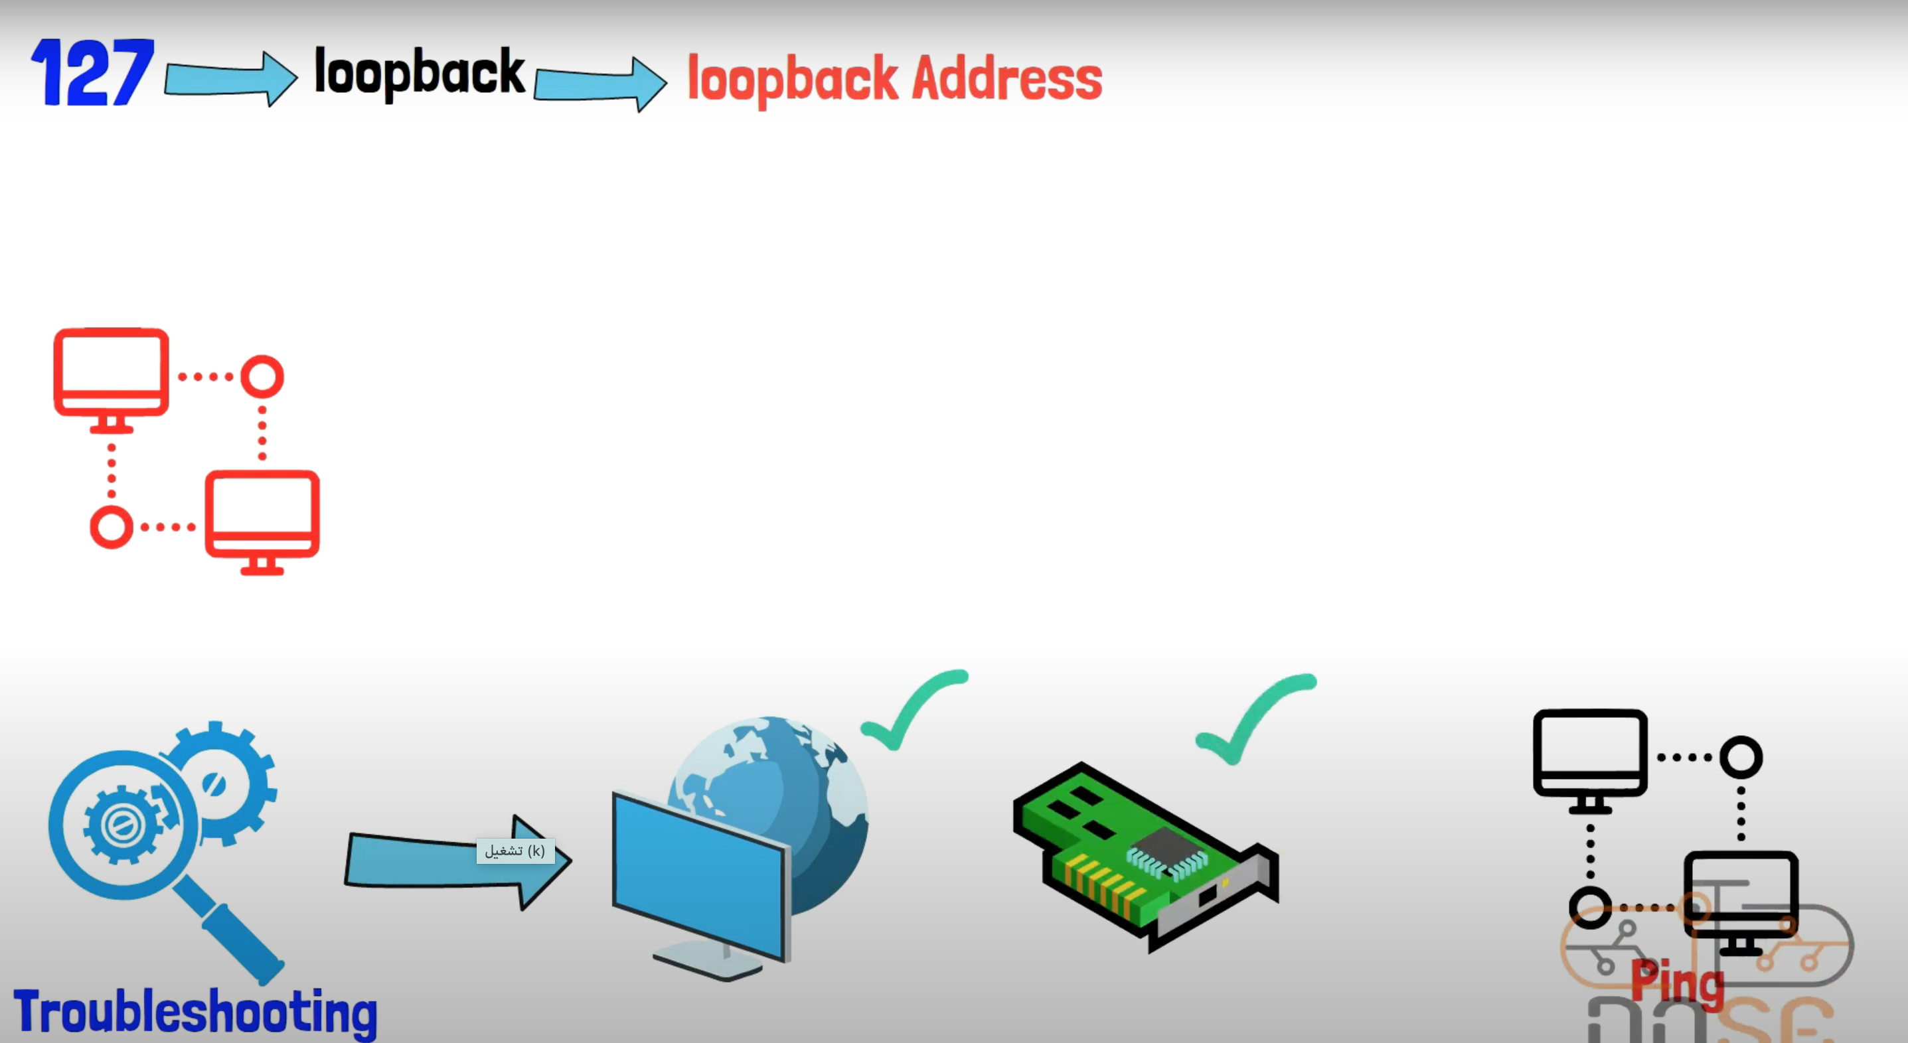
IP Address

Slide 13
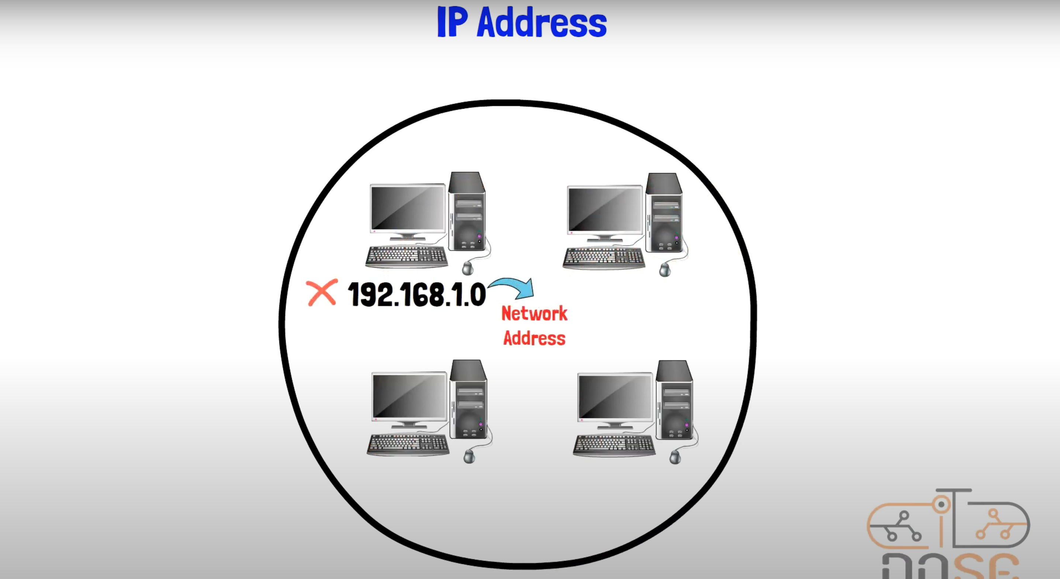
IP Address

Slide 14
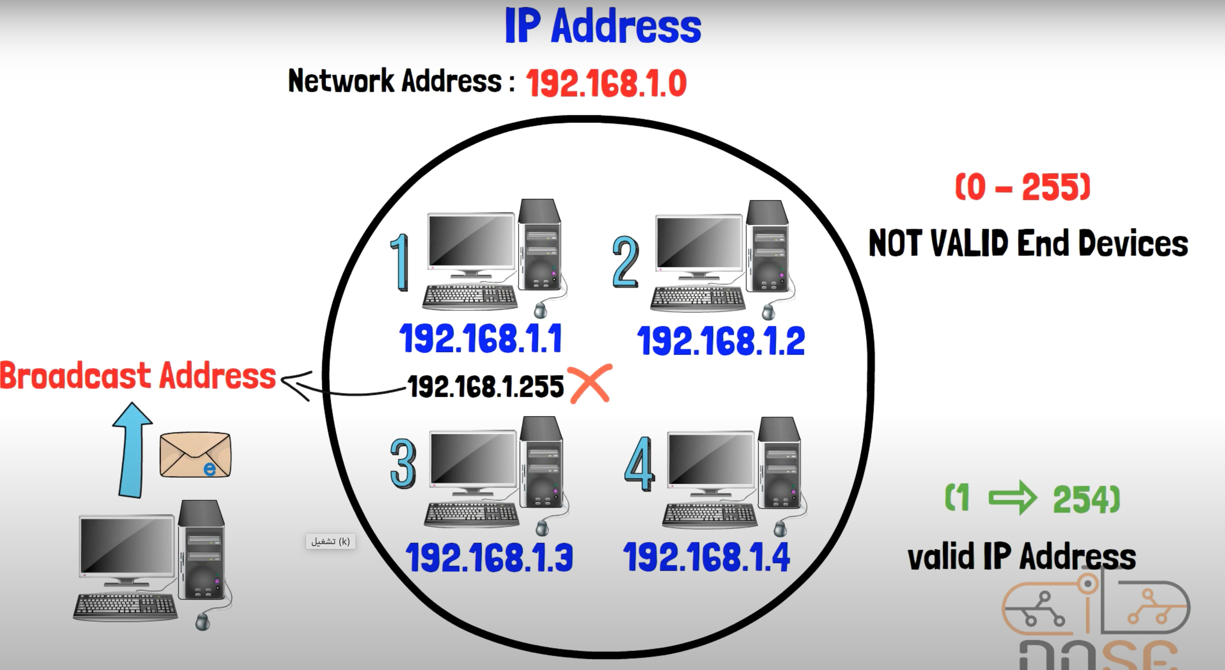
IP Address

Slide 15

Types of IP Address

Slide 16
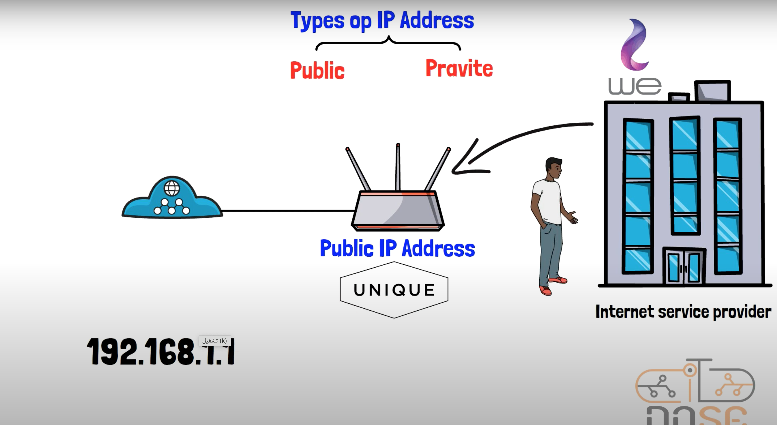
IP Address

Slide 17
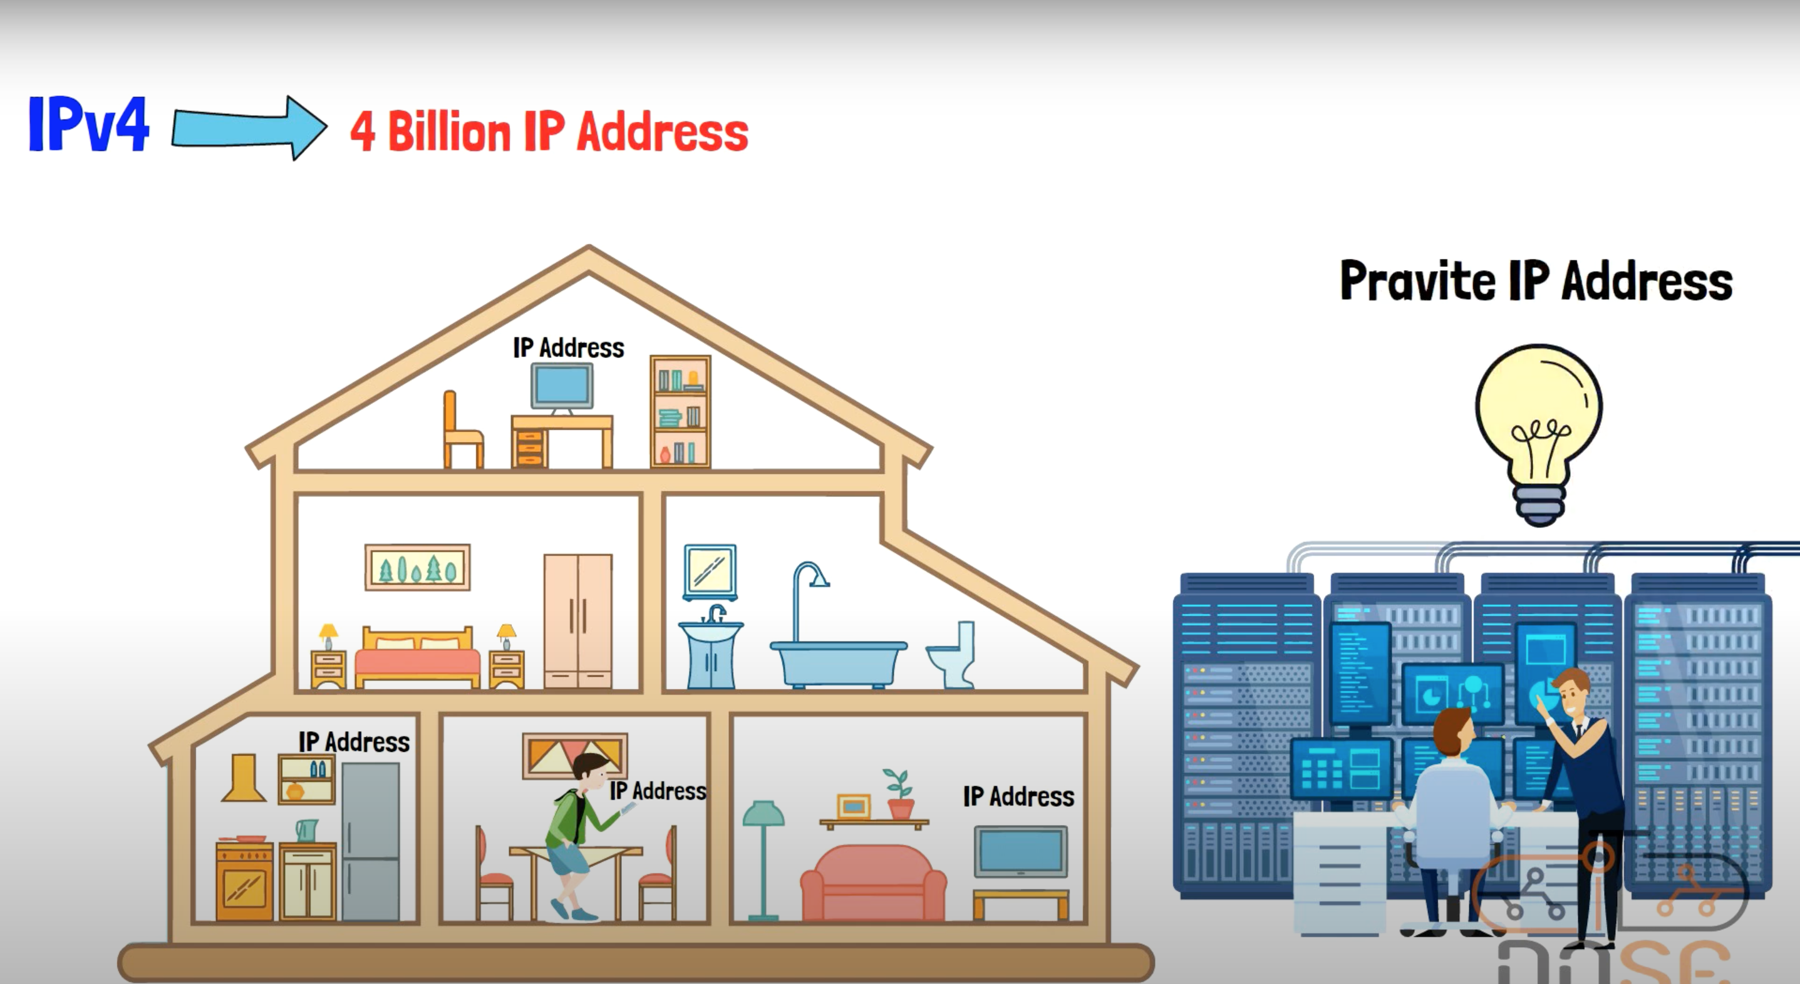
IP Address

Slide 18
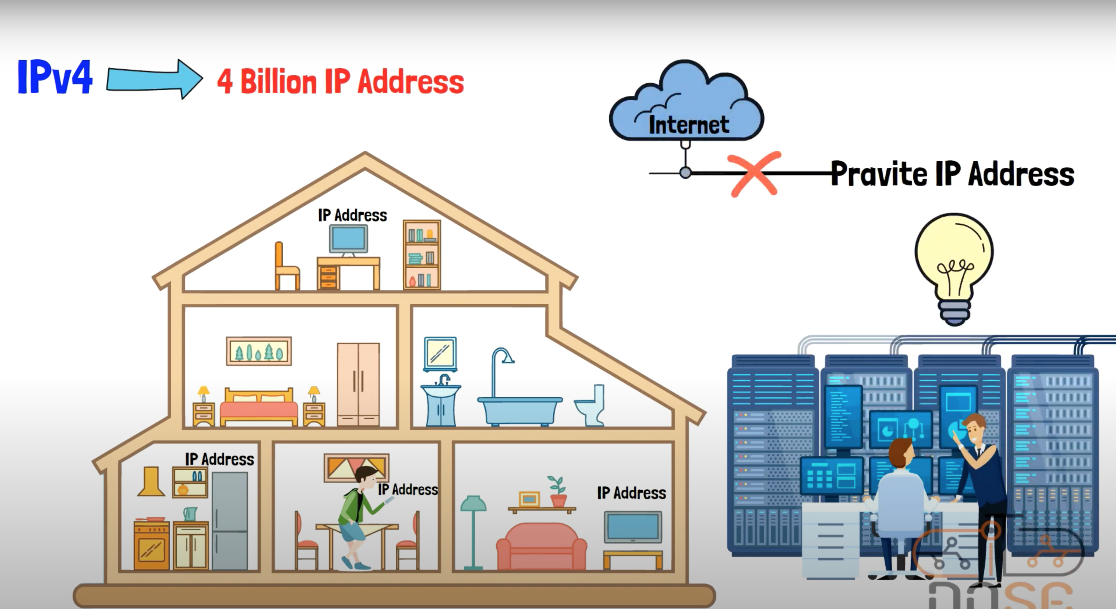
IP Address

Slide 19
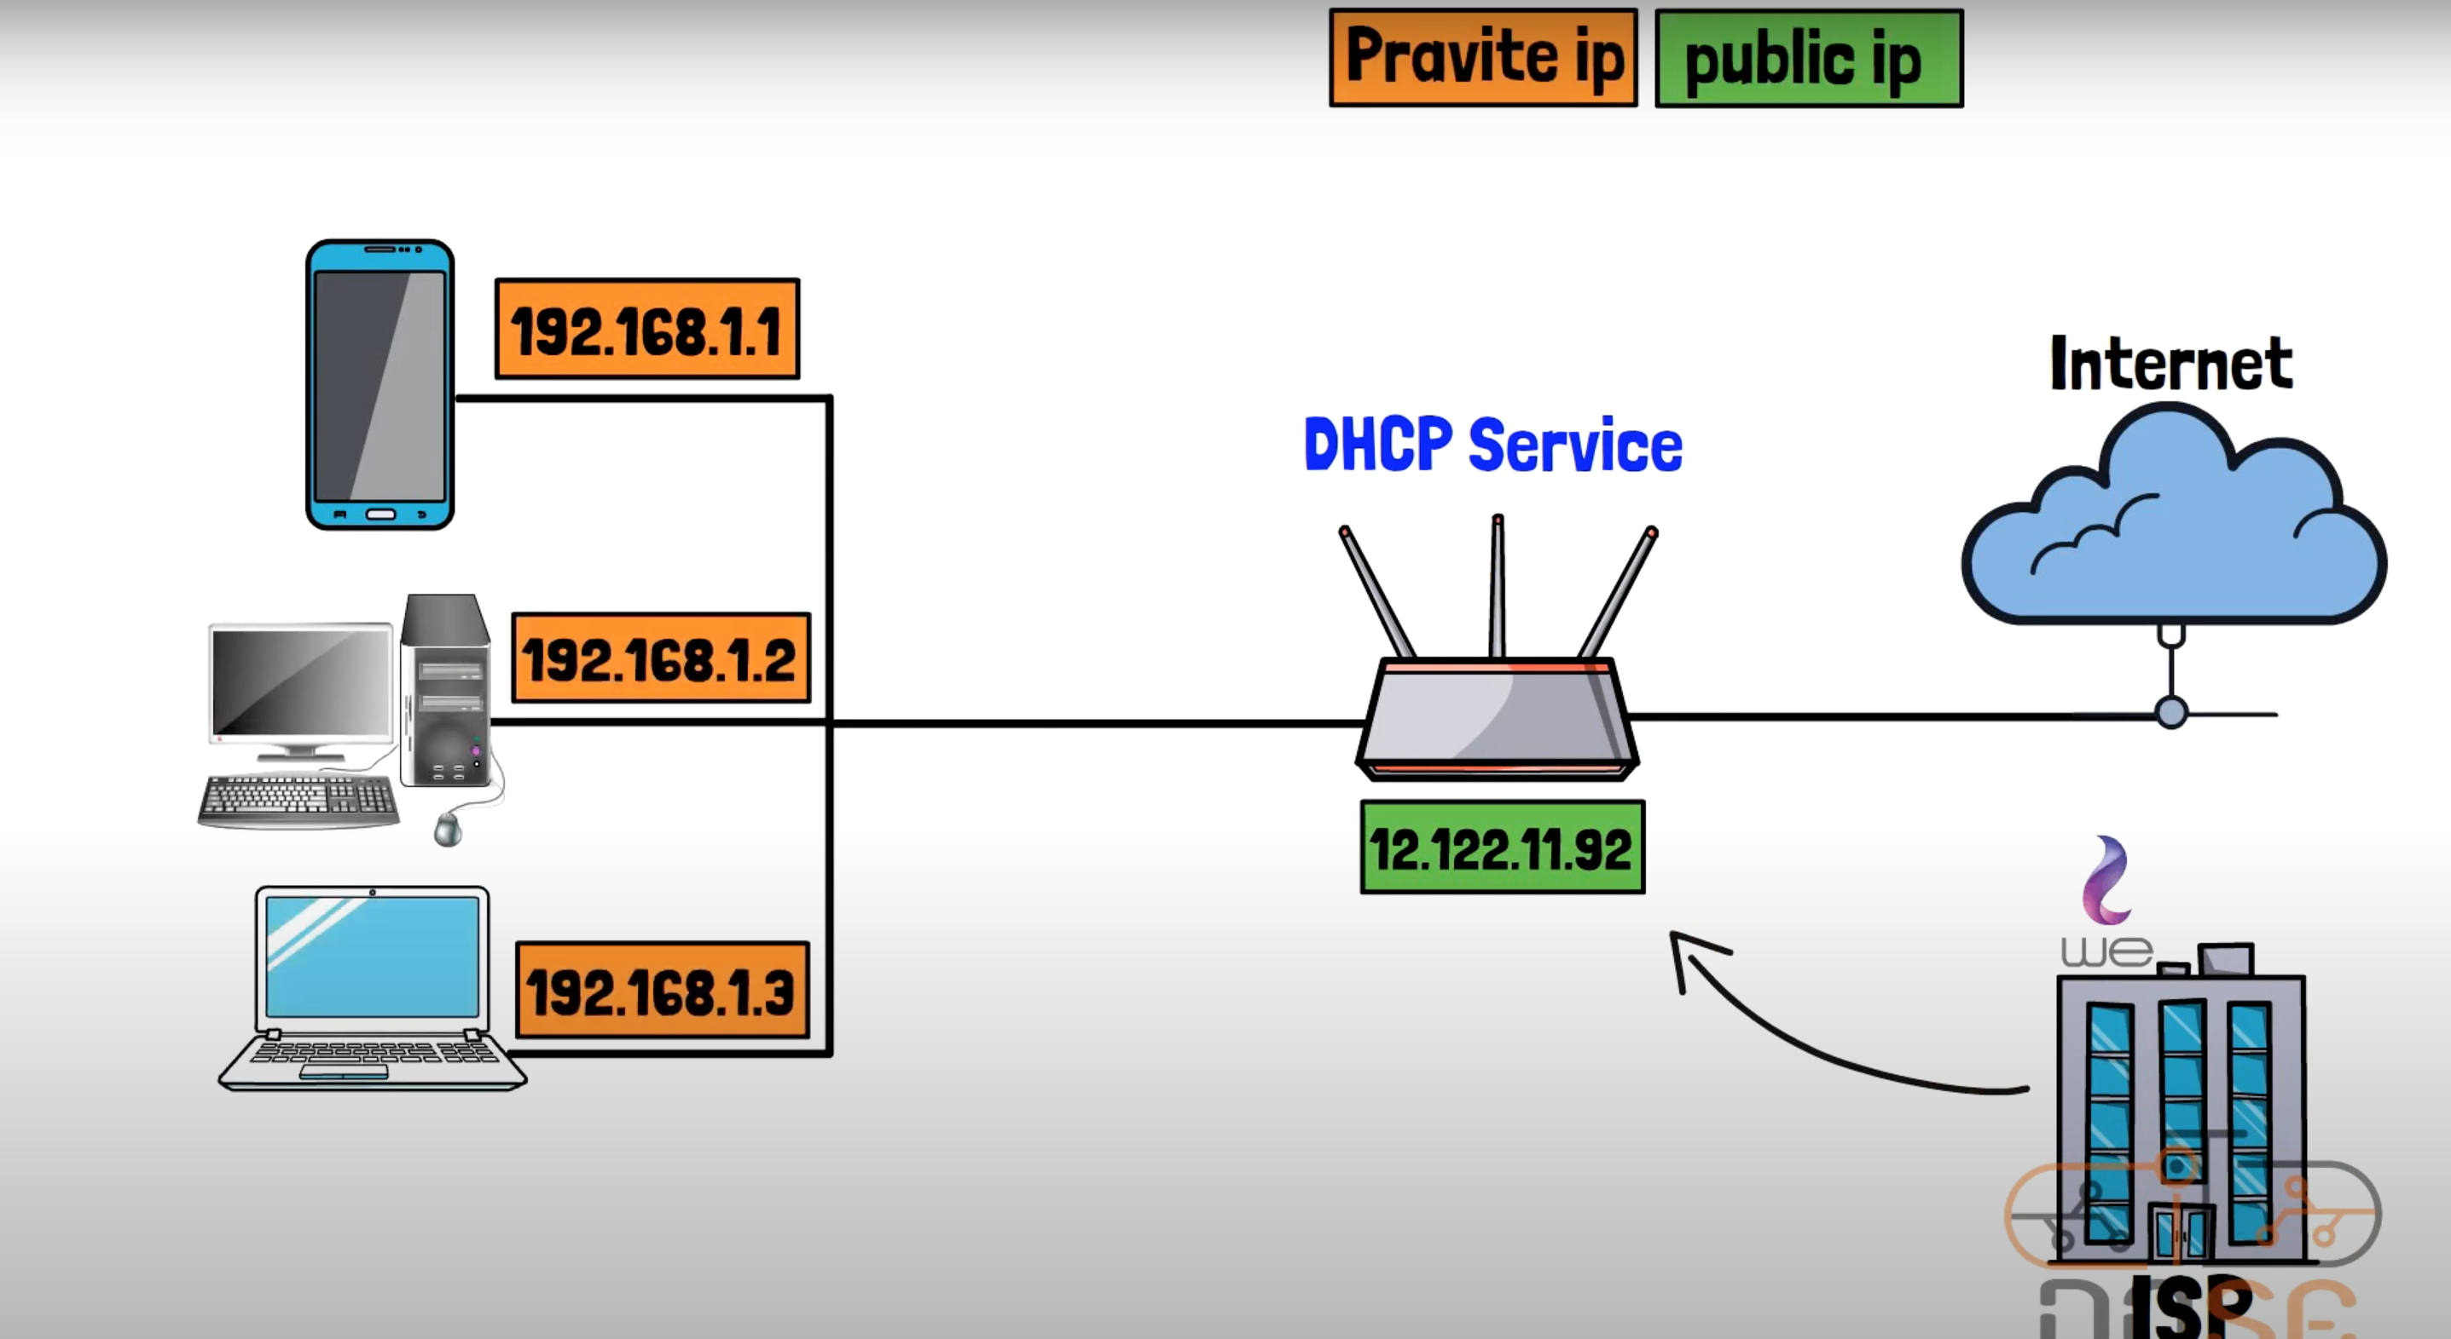
IP Address

Slide 20
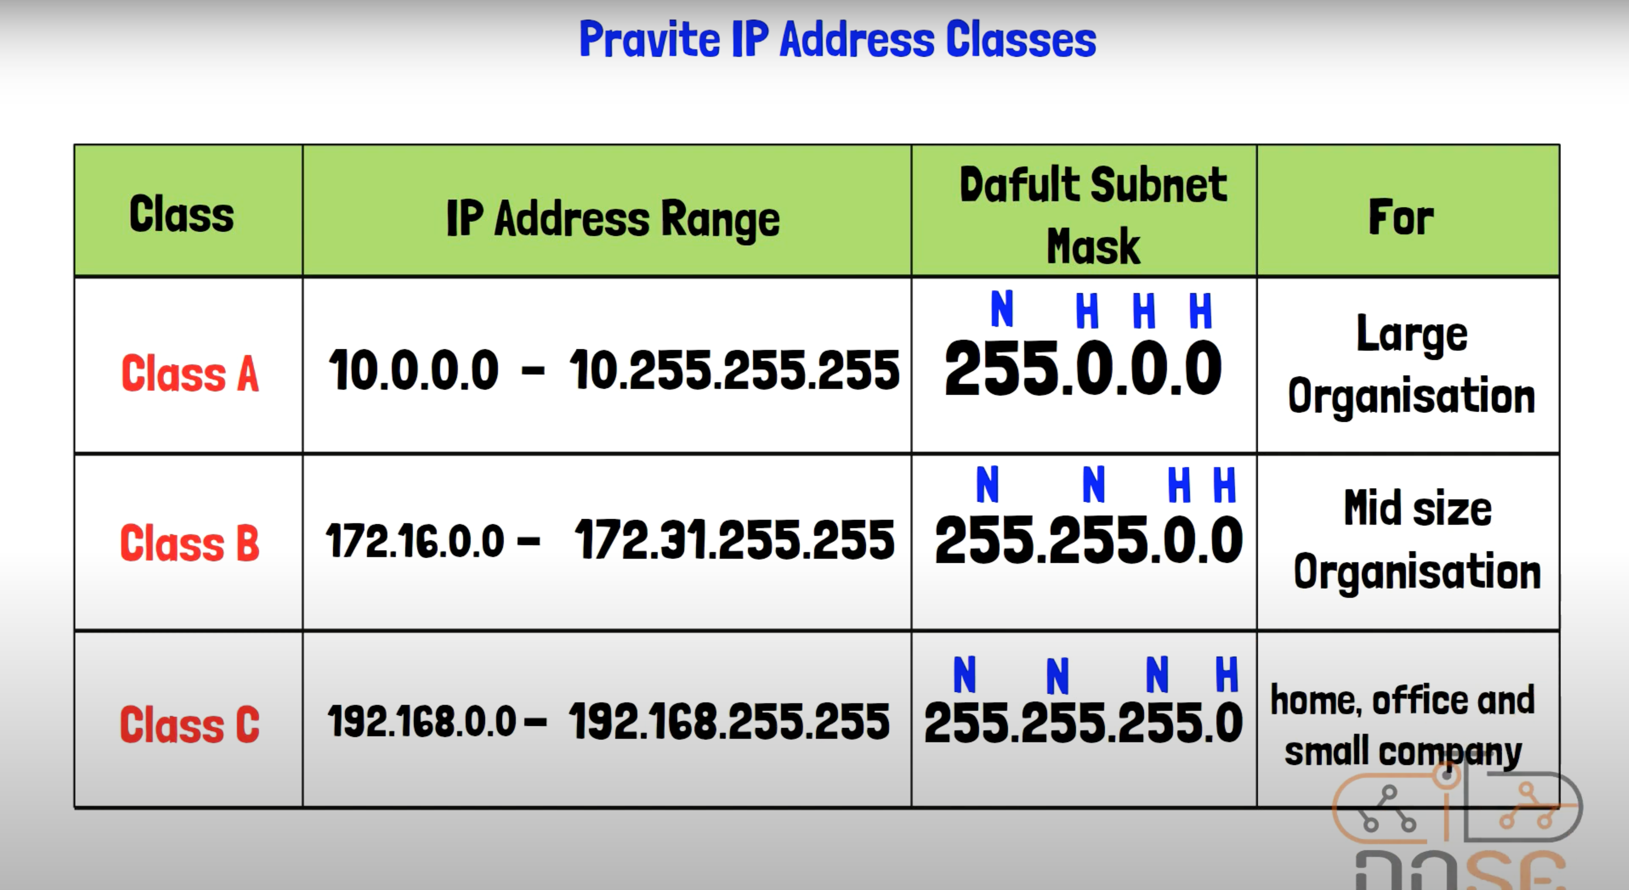
IP Address

Slide 21
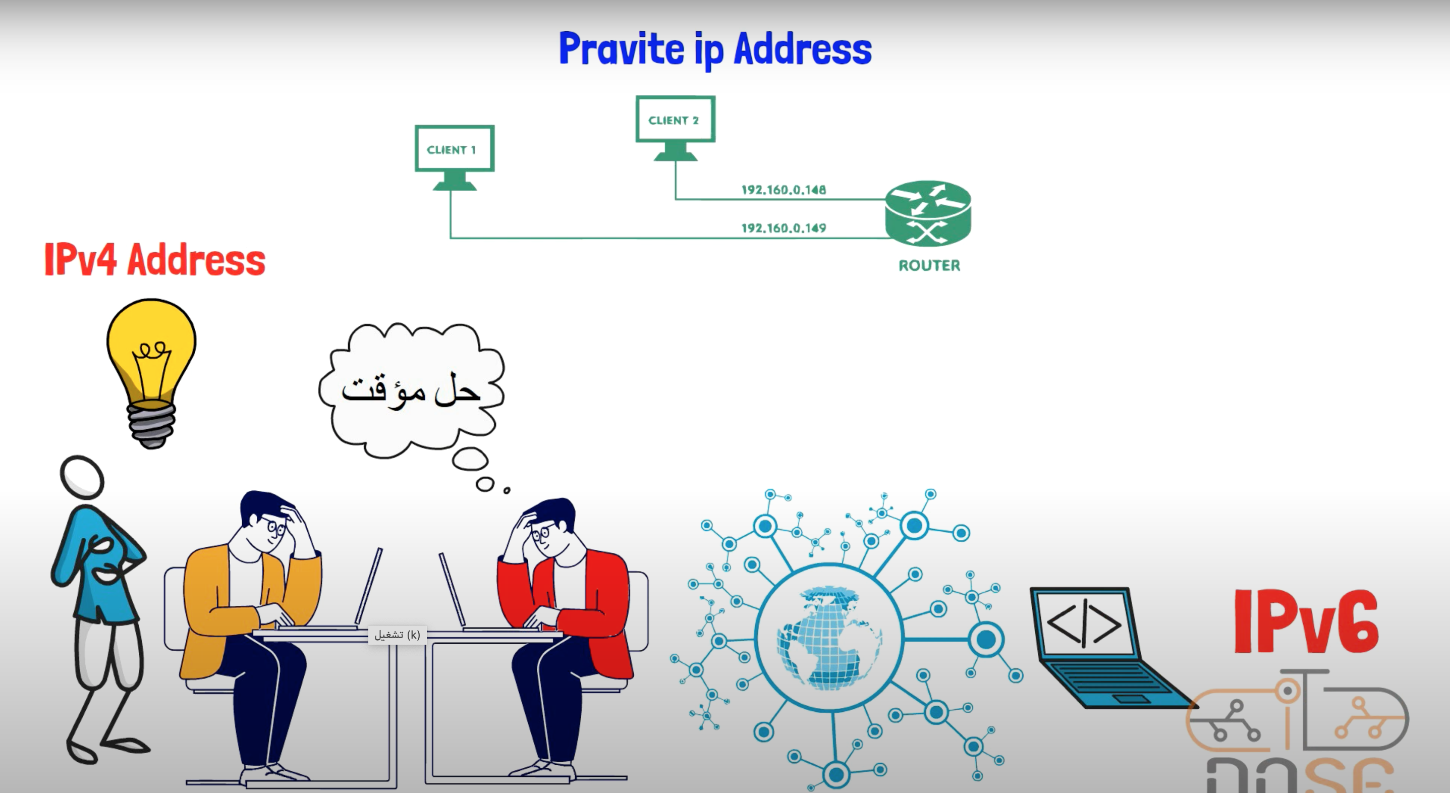
IP Address

Slide 22
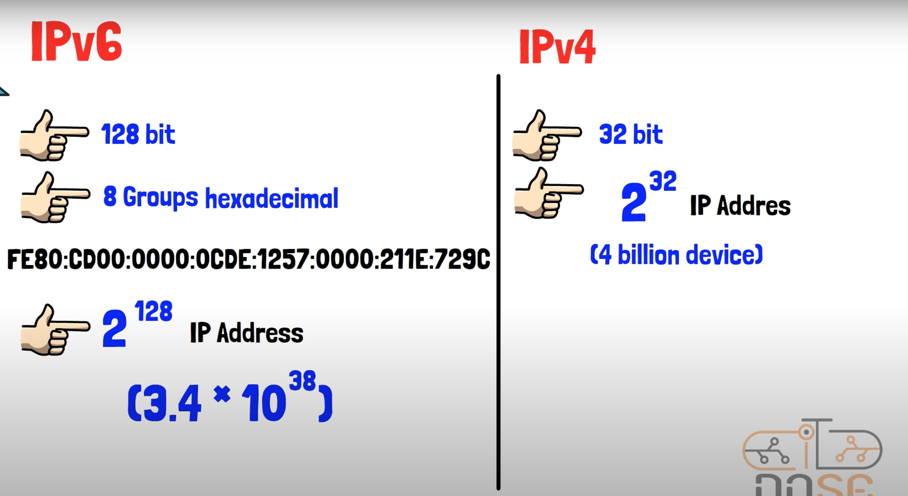
IP Address

